Slide 1
Topic: Measurement
EQ : How do I find the area of different shapes?
Get your VIVOS
- Number Ninja???????

Slide 2
Learning Intentions
Students will be able to
Find the area of different shapes

Slide 3
24
7
30
Measurement
Date:
EQ – How do I find the area of different shapes?
Area measures the surface of something

Slide 4
1 metre
1 cm
1 mm
1 metre
1 m²
1 mm
1 mm²
1 cm
1 cm²
1 square metre

Slide 5
24
7
30
Measurement
Date:
EQ – How do I find the area of different shapes?
Area measures the surface of something
Area foldable
What is the rule
Use the rule to complete the example. SHOWING FULL WORKING OUT
PEOPLE MATTER 100%RULE

Slide 6
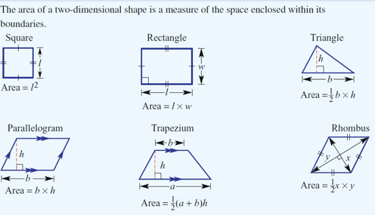

24
7
30
Measurement
Date:
EQ – How do I find the area of different shapes?
What rules have we not included. Write them down

Slide 7

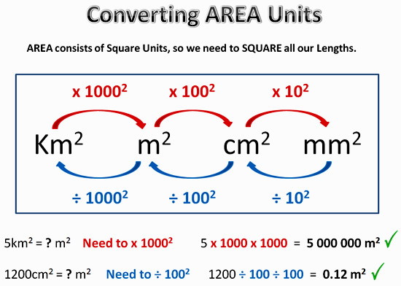
24
7
30
Measurement
Date:
EQ – How do I find the area of different shapes?

Slide 8
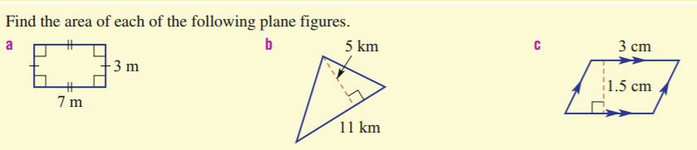
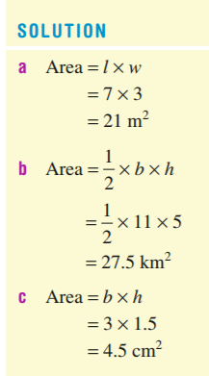
24
7
30
Measurement
Date:
EQ – How do I find the area of different shapes?
We will do these together:
Example 1:

Slide 9
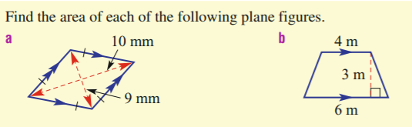
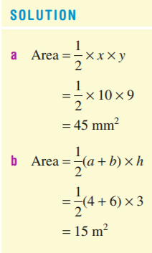
24
7
30
Area Review
Date:
EQ – How do I find the area of different shapes?
We will do these together:
Example 2:

Slide 10
Your turn…. LHS
Area Review Worksheet

Slide 11
Homework
Review your notes and write a summary answering the essential question.

